Slide 1

Building Modern Mobile Apps
Xamarin.Forms
Brent Edwards
Principal Lead Consultant
Magenic
Level: Intermediate

Slide 2
Brent Edwards
BrentE@magenic.com
@brentledwards
http://www.brentedwards.net
https://github.com/brentedwards

Slide 3
Mobile Tasks Source Code
Github
https://github.com/brentedwards/MobileTasks

Slide 4
What is Xamarin.Forms?

Slide 5
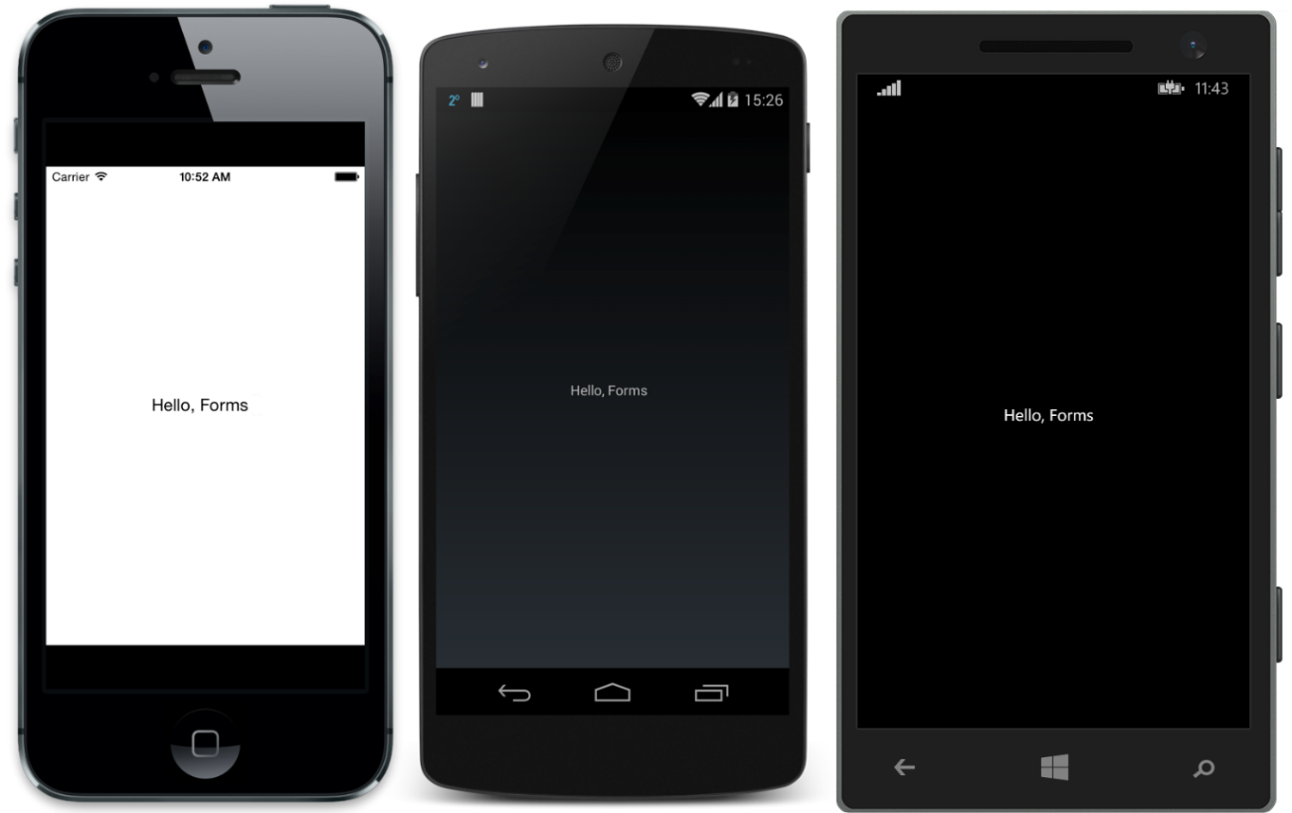
What is Xamarin.Forms?
Source: http://developer.xamarin.com/guides/cross-platform/xamarin-forms/introduction-to-xamarin-forms/

Slide 6
What is Xamarin.Forms?
A UI abstraction layer for Xamarin
Write apps once, run on:
iOS
Android
Windows

Slide 7
What is Xamarin.Forms?
Suite of controls that map to native controls on each platform
Rendered with native look-and-feel
Framework for navigation and data binding

Slide 8
How does it work?
Xamarin.Forms Solution
Xamarin.Android Project
Native Android
Xamarin.iOS Project
Native iOS
Universal Windows Project
Native Windows

Slide 9
History
Began with Mono
Open source project port of .NET to multiple platforms
Xamarin founded in 2011
Support Mono project
Develop commercial tools leveraging Mono

Slide 10
Dev System requirements

Slide 11
Dev System Requirements
Xamarin.iOS
Mac (Required)
Windows PC (Optional)
XCode
Visual Studio 2012+
Xamarin Plugin
Still has to network with Mac
OS X Yosimite+
Xamarin Studio (or VS for Mac)

Slide 12
Dev System Requirements
Xamarin.Android
Mac
Xamarin Studio (or VS for Mac)
Windows PC
Visual Studio 2012+
Xamarin Plugin
Windows PC
Xamarin Studio
OS X Yosimite+

Slide 13
Dev System Requirements
Universal Windows
Windows PC (Required)
Windows 10 *
Visual Studio 2015 *
Xamarin Plugin
* Unless targeting older version of Windows or Windows Phone

Slide 14
Testing
iOS Simulator
On Mac only
Android Emulator
Default Emulator
Genymotion Emulator
Visual Studio Emulator
Windows Simulator or Device
On Windows only

Slide 15
Device Testing
Test on real devices too!
Emulators/Simulators are only an approximation
Real devices have different constraints and limitations
Test on multiple devices for each target platform

Slide 16
Foundation

Slide 17
Xamarin.Forms Foundation
4 Main Classes everything is built on
View
Page
Layout
Cell

Slide 18
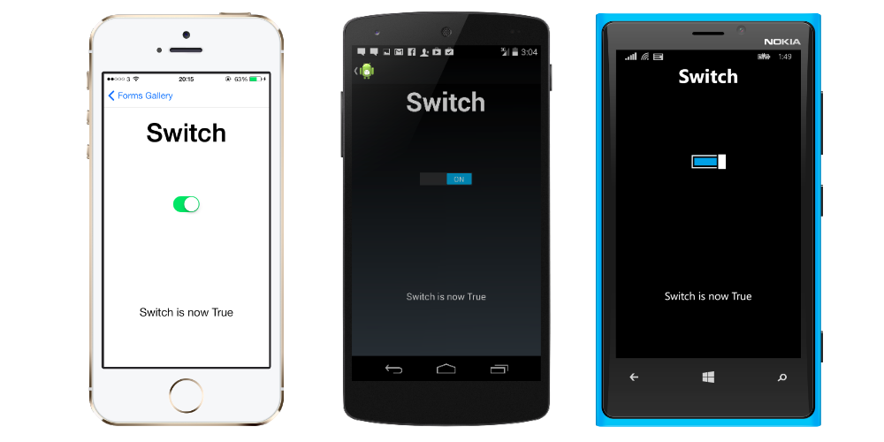
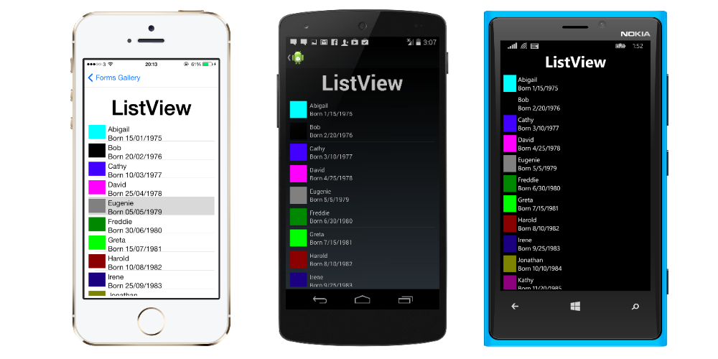
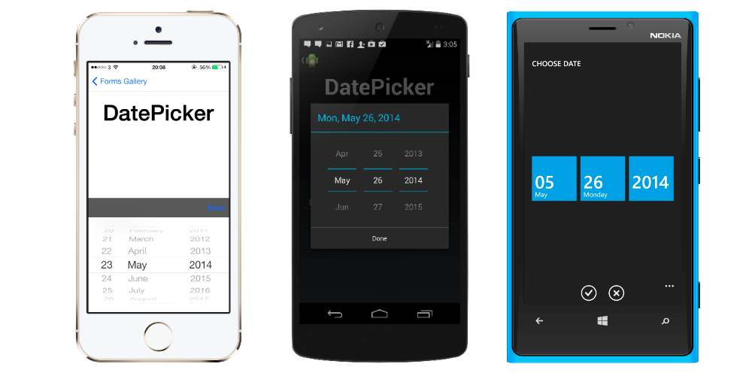
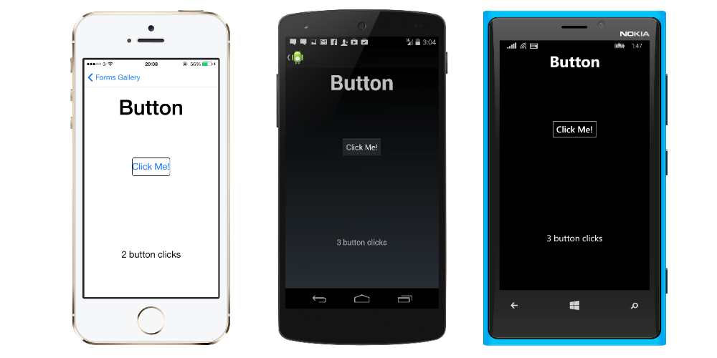
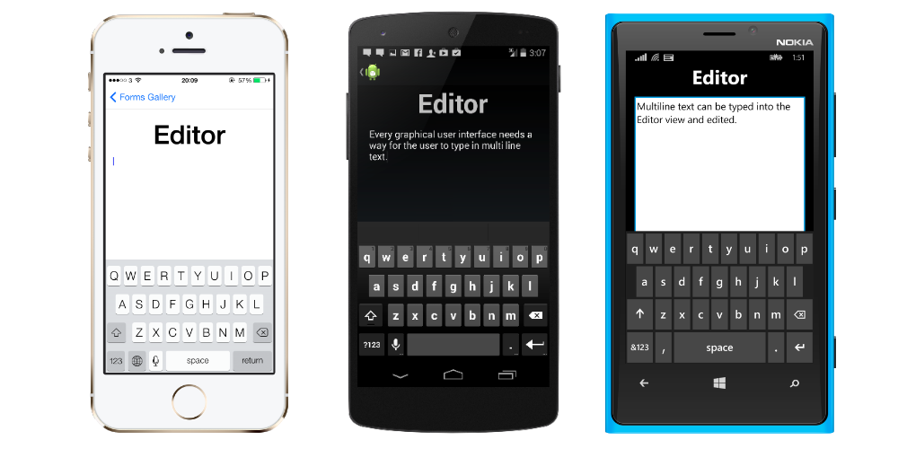
View
Typically called control or widget on native platforms
Examples:
Button
Editor
DatePicker
ListView
Switch

Slide 19
Page
Android
Activity
iOS
View Controller
Windows Phone
Page

Slide 20
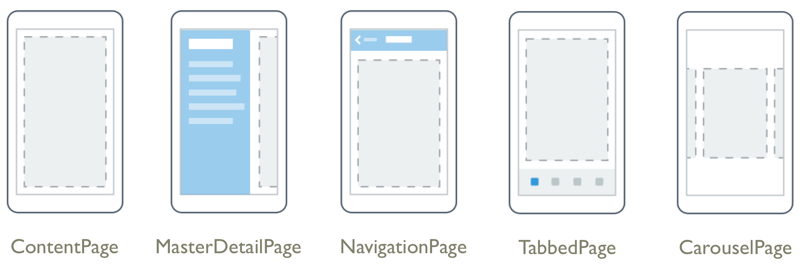
Page Examples
Source: http://developer.xamarin.com/guides/cross-platform/xamarin-forms/controls/pages/

Slide 21
Layout
Type of view used for… Layout!
Container for other Layouts or Views
2 Types
Managed
Unmanaged

Slide 22
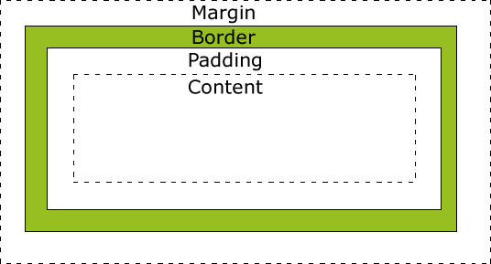
Managed Layout
Handles sizing and positioning child views
Follow CSS Box Model
Source: http://www.w3schools.com/css/css_boxmodel.asp

Slide 23
Unmanaged Layout
Does not handle sizing and positioning of child views
Developer sets this
Allows for precise positioning
Requires testing on many device sizes

Slide 24
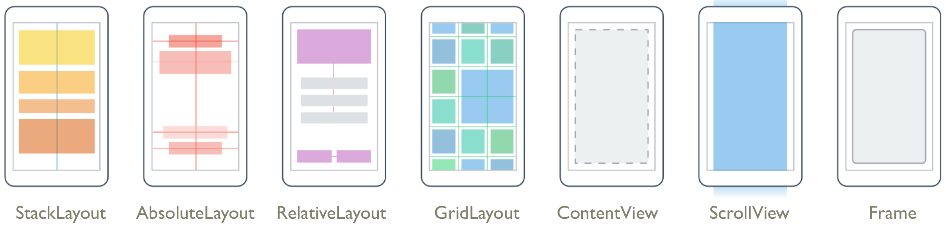
Layout Examples
Source: http://developer.xamarin.com/guides/cross-platform/xamarin-forms/controls/layouts/

Slide 25
Cell
Describes how items in a list or table should be drawn
Not a visual element
Like a DataTemplate in XAML
Designed for ListView and TableView

Slide 26
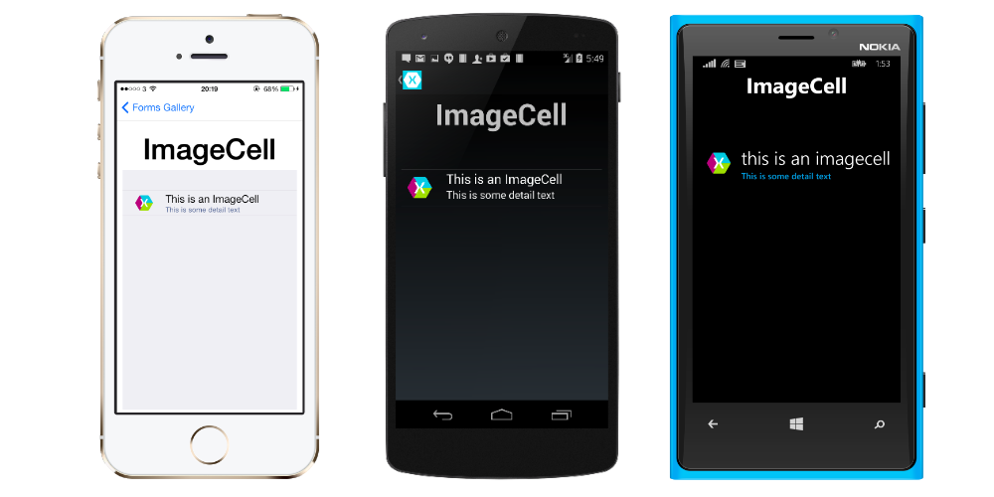
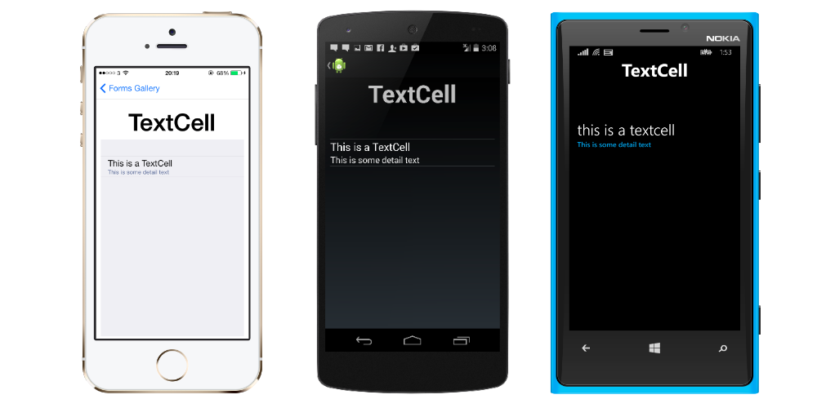
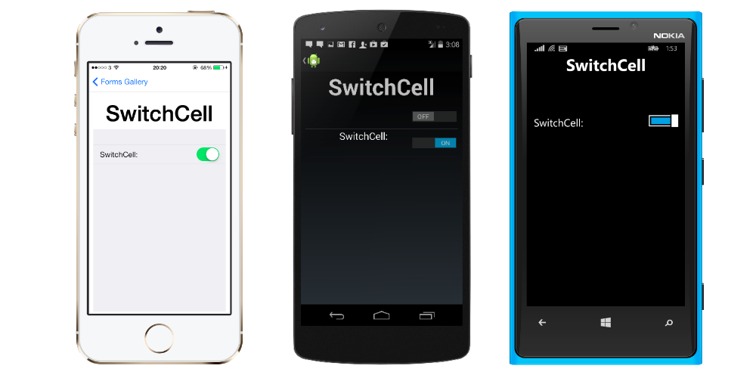
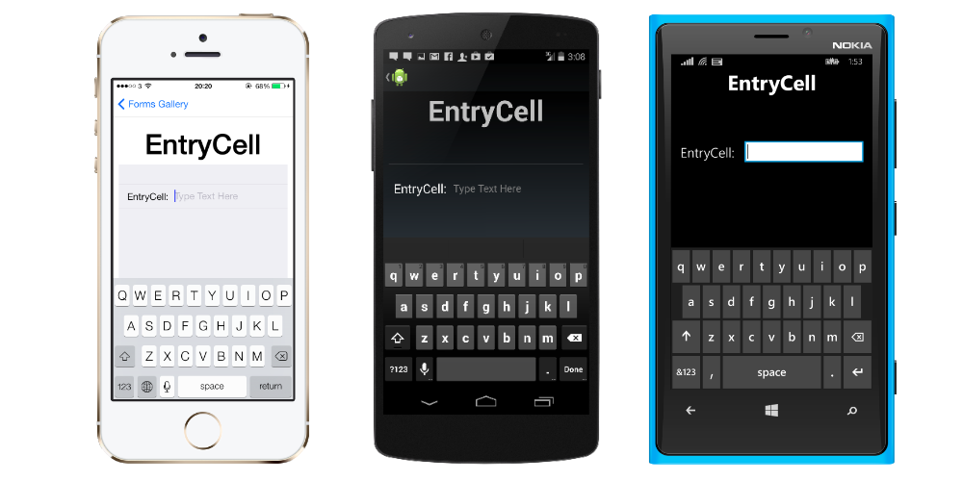
Cell
Examples:
EntryCell
SwitchCell
TextCell
ImageCell

Slide 27
Xamarin.Forms UI
[DEMO]

Slide 28
Going Custom

Slide 29
Going Custom
What about custom controls?
Create a custom Renderer!
Renderers output native controls for each platform
All controls use Renderers

Slide 30
Custom Renderers
Can tweak existing controls
Can create completely new controls
Lots of power

Slide 31
Custom Renderers
How to do it
Create custom control
Can inherit from existing types
Create custom renderer for each platform
This dives into Xamarin proper
Bind them together with ExportRenderer attribute
Tells Xamarin that they are a pair

Slide 32
Custom Renderers
[DEMO]

Slide 33
MVVM
Model-View-ViewModel

Slide 34
MVVM
View
Presentation
View Model
Presentation Logic
Model
Business Logic

Slide 35
Why is MVVM Cool?
Separates Presentation from Functionality
Promotes Testability
Works great with Data Binding
Easy collaboration with Designers
Makes it easy to change out the View layer!

Slide 36
MVVM
[DEMO]

Slide 37
Application Lifecycle
Support of multiple platforms == lowest common lifecycle
3 virtual methods with Application class
OnStart
OnSleep
OnResume

Slide 38
Unit Tests
Create Xamarin.UITest project
Can run tests locally within Visual Studio
Then deploy to Xamarin Test Cloud

Slide 39
Continuous Integration
CI Build Servers can be configured for Xamarin
Install Visual Studio and Xamarin tools
iOS will require a Mac OS X machine for build server
This machine can create final app package

Slide 40
Thoughts on Xamarin.Forms

Slide 41
Strengths
Similar to Xamarin
Working with Visual Studio and C#
Native look-and-feel
Lots of code re-use
Including UI code

Slide 42
Weaknesses
Mac required (for iOS)
Connection can get flakey
More challenging to customize UI

Slide 43






Which Xamarin approach is best for your app?
Xamarin.Forms is best for:
Xamarin.iOS / Xamarin.Android is best for:
Data entry apps
Prototypes and proofs-of-concept
Apps that require little platform-specific functionality
Apps where code sharing is more important than custom UI
Apps that require specialized interaction
Apps with highly polished design
Apps that use many platform-specific APIs
Apps where custom UI is more important than code sharing
Learn more: xamarin.com/platform
Learn more: xamarin.com/forms

Slide 44
Conclusion
Xamarin.Forms is a solid choice for non-complex apps
As close to native as C# gets
Worth checking out for C# shops

Slide 45
Questions?

